Slide 1
Module-4
Distribution and Promotion
Presentation by
Dr. Basavaraj S.Kudachimath

Slide 2
Discussion Points
Roles and purpose of Marketing Channels,
Factors Affecting Channel Choice
Channel Design,
Channel Management Decision,
Channel Conflict,
Designing a physical Distribution System.
Promotions- Marketing communications- Integrated Marketing Communications
(IMC)-communication objectives,
Steps in developing effective communication.
Advertising:
Advertising Objectives, Advertising Budget, Advertising Copy, AIDA model,
Traditional Vs Modern Media- Online and Mobile Advertising, social media for Advertising. Push-pull strategies of promotion.

Slide 3
Marketing Channels
Meaning of Marketing or Distribution Channel:
A distribution channel is a chain of businesses or intermediaries through which goods or services passes until it reaches the end consumer. It can include wholesalers, retailers, distributors and even the internet itself.

Slide 4
Purpose of Distribution Channel
Flow of goods and services.
Prospecting sale.
Provide supportive services.
Cost minimization involved in transport and product handling.
Flow of information.

Slide 5
Functions of Distribution Channels
Provide market information.
Promotion.
Develop customer contacts
Breaking the bulk.
Financing function.
Selling Function.
Risk taking.
Creation of Time and place Utility.
Supply in Assortments.
Transfer of Title.

Slide 6
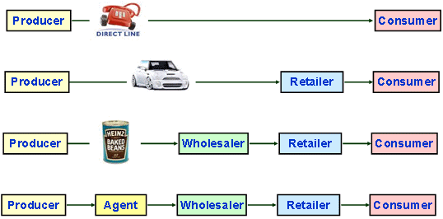
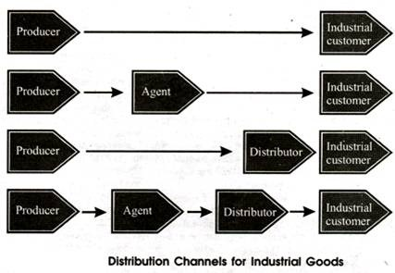
Types of Marketing Channels
Consumer Channels
Industrial Channels

Slide 7
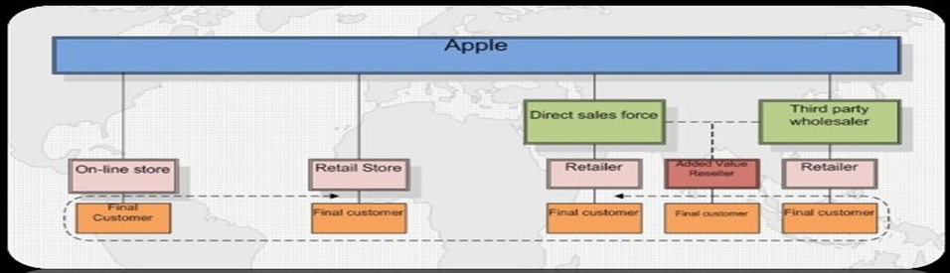
Multiple Distribution Channels
Multi-channel distribution involves a business using more than one type of distribution channel reaching the same target customers.
Apple Products Distribution Channel

Slide 8
Factors Affecting Channel Choice:
D.Middlemen Considerations
Sales volume potential
Middlemen availability
Services provided by middlemen
Cost of channel
F: Environmental Channels.
Economic condition
Legal Restrictions
Product characteristics.
Industrial/ Consumer products.
Perishability.
Unit Value.
Purchase frequency.
Product breadth ( Larger breadth lesser the channel length).
B. Company Characteristics.
Financial strength.
Marketing policies.
Size of the company.
Product mix.
C. Consumer characteristics.
Consumer buying habits.
Market location.
Number of consumers.
Size of orders.

Slide 9
Channel Design Decision
Channel design refers to those decisions involving the development of new marketing channels or modifying the existing marketing channels for effective distribution of goods and services to customers.
Channel design depends upon;
Nature of the product.
Customer expectation from distribution.
Type of market targeted.

Slide 10
Steps involved in Channel Design Decision
Recognizing the need of the channel
Identifying the functions
Linking Product Charecteristics
Evaluation of Distribution Environment
Evaluate competitors channel design.
Matching the channel design to company resources
Evaluating the alternatives and selecting the best.

Slide 11
Channel Management Decisions
Steps in channel management:
Recruiting channel members
Selecting channel members.
Training channel members.
Motivating channel members.
Evaluating channel members.
Modifying channel arrangements.
Managing channel relations.

Slide 12
Channel conflict:
Channel conflict is a situation of discord or disagreement between channel members from the same marketing channel system. Conflict always has a negative connotations and is driven more by feelings than facts.
Types of channel conflicts:
Vertical channel conflict.
Horizontal channel conflict.
Multi level channel conflict.

Slide 13
Causes of Channel conflict
Goal incompatibility. ( Goal difference)
Role ambiguity. ( Confusion in roles of manufacturers sales force and distributors sales force)
Differences in perception of the market. ( Manufactirers may perceive positive market where as dealers may perceive negative market)
Geographic or demographic distribution misalignment.
Differences between manufacturers and channel members regarding market opinions.

Slide 14
Remedies of channel conflicts:
Proper communication.
Super ordinate goals. ( Goals to be fixed which cannot be achieved by single person)
Persuasion.
Negotiation.
Coalition or combining the channels.
Mediation and arbitration for solving conflict ( Third party entry to solve problems)
Judicial appeal.

Slide 15
Promotion Mix:
Promotion in 4Ps of marketing mix implies the process of acquainting the target consumers about the brand and convincing them to buy the product or service. The purchasing behavior of consumers is heavily impacted by Promotion, and it is one of the most powerful Ps of the marketing mix.

Slide 16
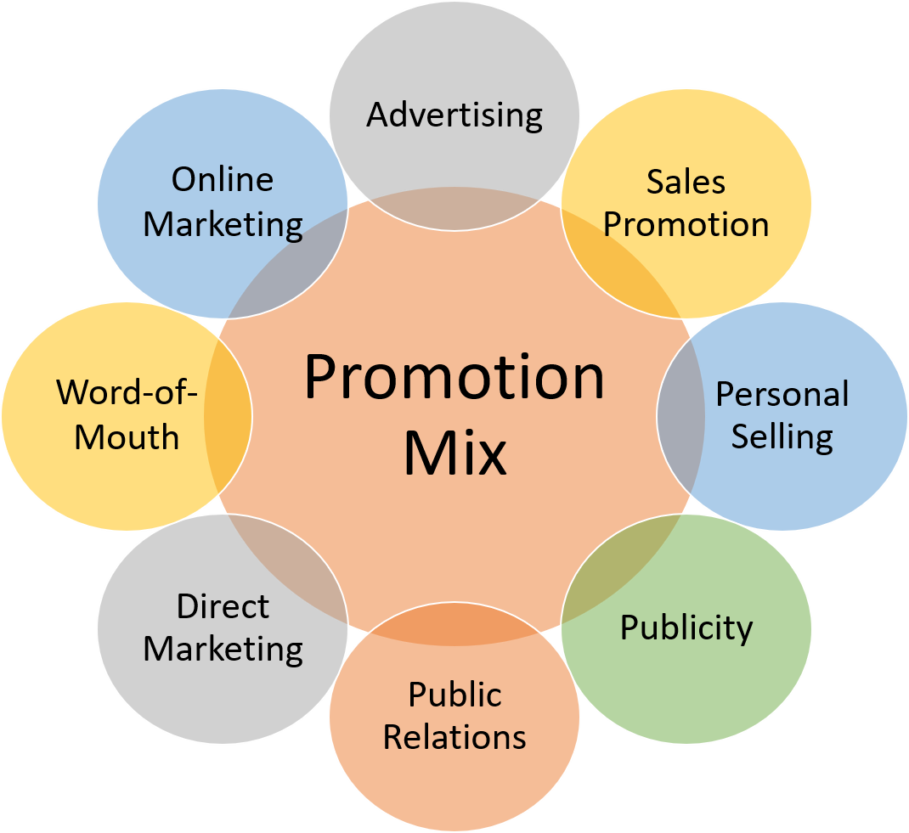
Elements of Promotion Mix

Slide 17
Marketing communications
Marketing communications (also known as marcom) is the messages and media that marketers use to communicate with target markets. Examples of marketing communications include traditional advertising, direct marketing, social marketing, presentations and sponsorships.

Slide 18
The Role of Marketing Communications
Reminding
Informing
Persuading

Slide 19
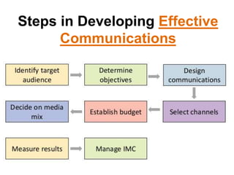

Slide 20
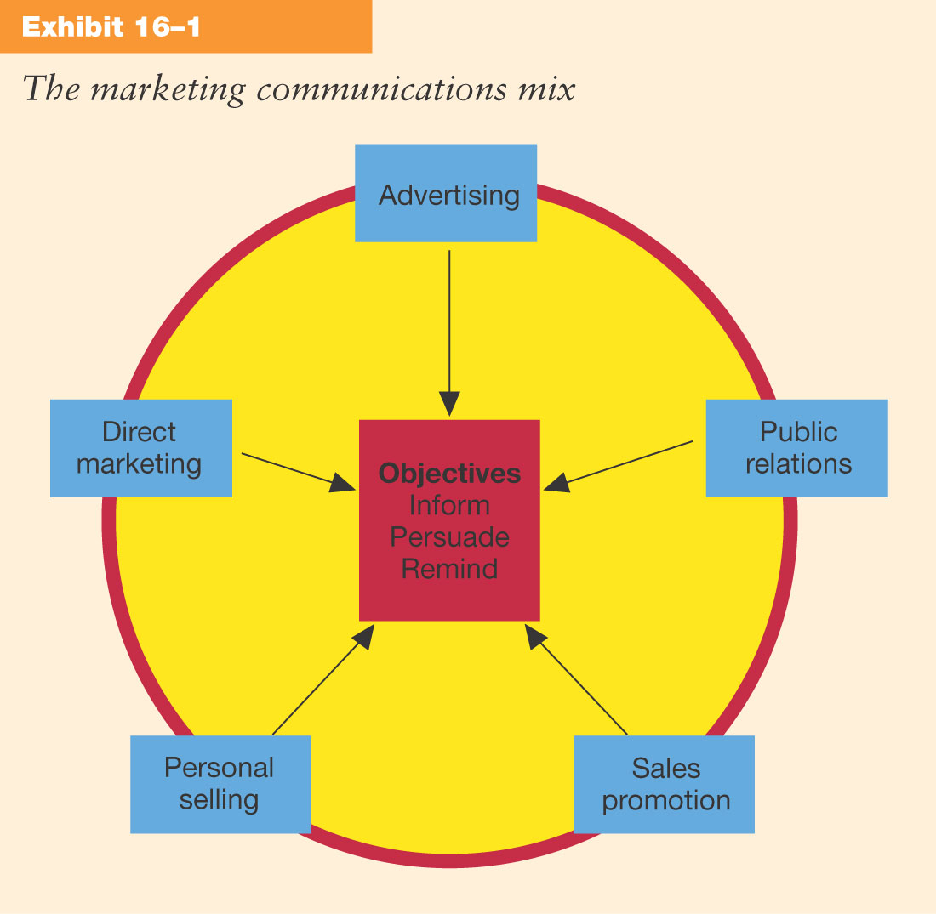
The Marketing Communications Mix

Slide 21
Integrated Marketing Communications
Integrated Marketing Communications (IMC):
  The strategic integration of multiple means of communicating with target markets to form a comprehensive, consistent message.

Slide 22
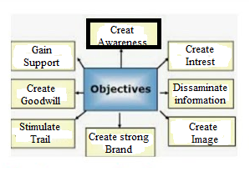
Objectives of IMC

Slide 23
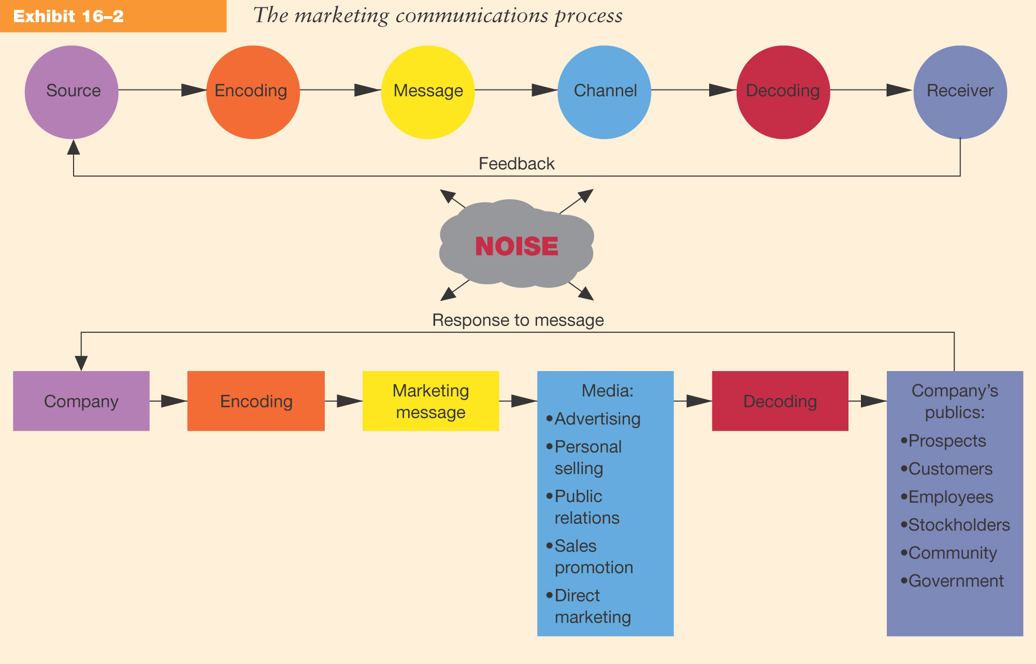
The Marketing Communications Process

Slide 24
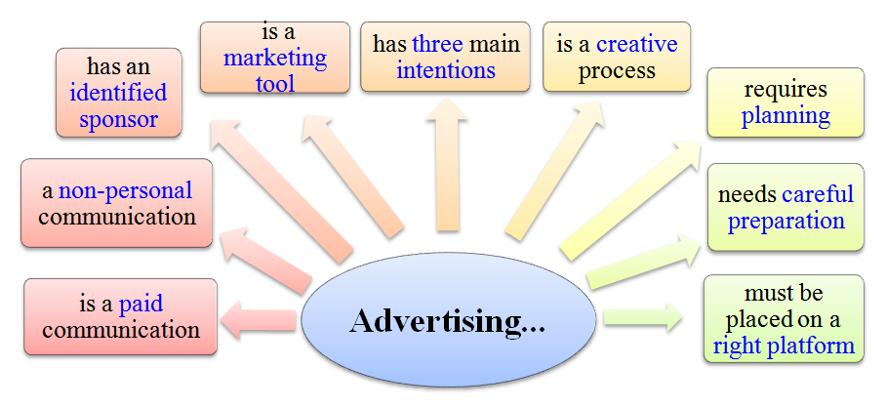
Advertising:

Slide 25
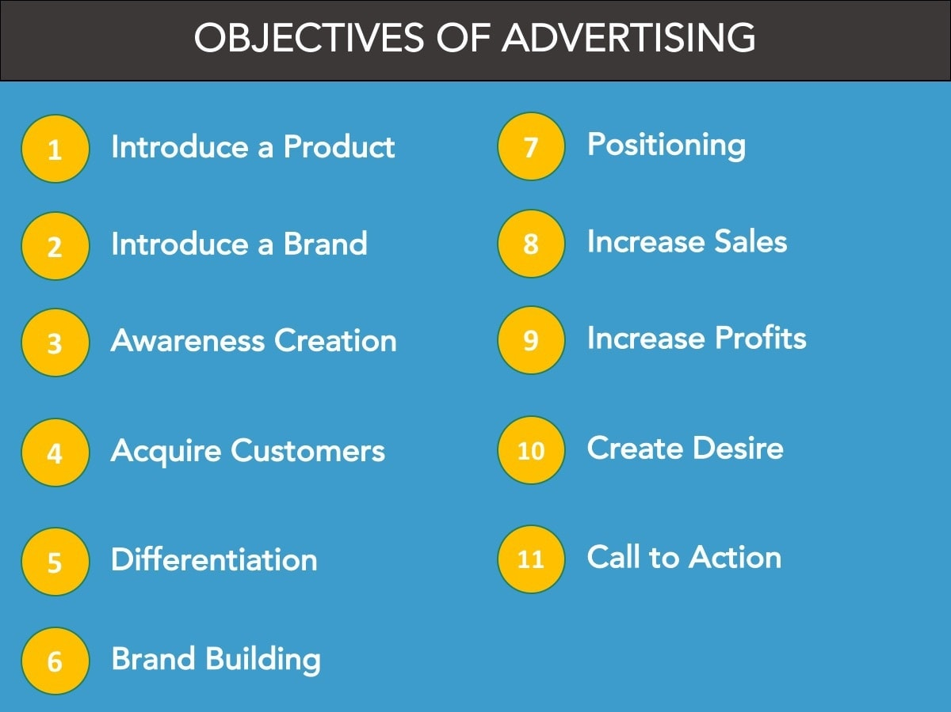
Advertising Objectives

Slide 26
Advertising Budget,
An advertising budget is an amount set aside by a company planned for the promotion of its goods and services. Promotional activities include conducting a market survey, getting advertisement creatives made and printed, promotion by way of print media, digital media, and social media, running ad campaigns, etc.

Slide 27
The advertising budget of a company is based on the following factors:
Type of advertising campaign that it intends to run
Selection of target audience
Type of advertising media
Company’s objective of advertising

Slide 28
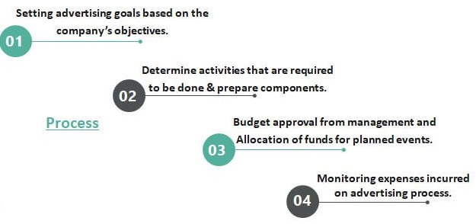
Process of Advertising Budget

Slide 29
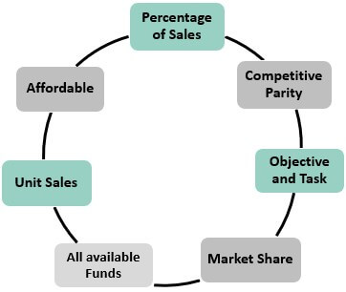
Advertising Budget Methods

Slide 30
Factors affecting Advertisement Budget:
Existing Market Share: A company with a lower market share will be required to spend more on its promotional activities. On the other hand, companies with larger market shares can spend less on their promotional activities.
The competition level in the industry: If there is a high competition level in the industry in which the company operates, the advertising budget would be required to be set on a higher side to get noticed by audiences. In case a monopoly exists or where there is the least level of competition involved, the company will need to invest less in marketing.
Stage of the Product Life Cycle: It is a well-known fact that in the initial introduction and growth stages of a product or service, more amounts would be required for advertising. While in the later stages of the product life cycle, the need for advertising will decline.
Decided frequency of Advertisement: The advertising budget will also depend on how frequently a company wants to run its ads. Frequent ads will call for a greater budget.

Slide 31
Advertising Copy
Ad copy is content that encourages a potential buyer to take action and purchase a product. By invoking an emotional response, communicating value and addressing doubt, effective ad copy can increase a company's sales and profits.
Types of Ad copy:
Human interest ad copy.
Educational ad copy.
Reason why? ad copy.
Institutional ad copy.
Suggestive ad copy.

Slide 32
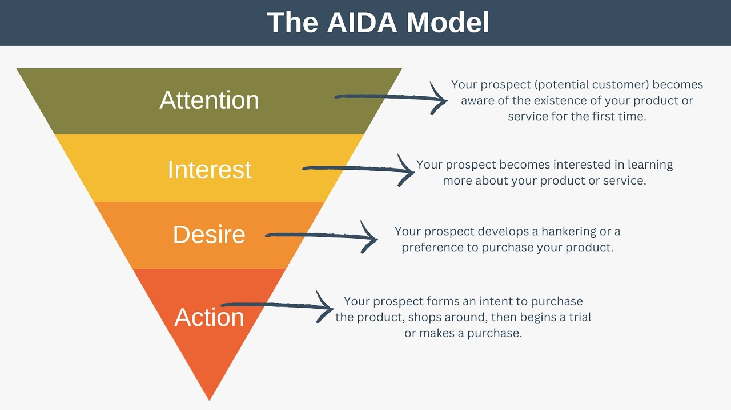
AIDA model
The AIDA Model, which stands for Attention, Interest, Desire, and Action model, is an advertising effect model that identifies the stages that an individual goes through during the process of purchasing a product or service.

Slide 33
Traditional and modern media
There are two main types of media: traditional media and new media. Traditional media includes print media, such as newspapers and books, and broadcast media, such as television and radio. New media includes digital media, such as the Internet and social media.

Slide 34
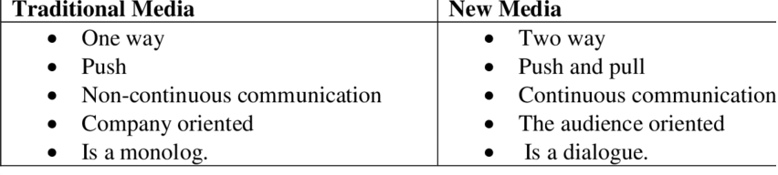
Differences between traditional and modern media

Slide 35
Traditional Vs. Modern Media
Traditional media are
Television advertisements.
Radio advertising.
Print advertising.
Direct mail advertisements.
Billboards and off-site signs.
Cold calling.
Door-to-door sales.
Banner ads.
Modern media are
Blogs.
Email.
Music and television streaming services.
Social media networks.
Virtual and augmented reality.
Websites.
Mobile and online platforms.

Slide 36
Thank You

